Slide 1
Green Communities
For Harwich
Harwich Energy Committee

Slide 2
What is a green Community?
Why become a green community?
A Green Community meets five criteria established by the State to improve energy efficiency.
Designation as a Green Community makes a municipality eligible for financial and technical support to reduce energy use by 20% over 5 years, thereby decreasing spending on energy.
These funds cover spending the Cape Light Compact’s Energy Efficiency Program doesn’t.
Reducing energy use helps shrink our Town’s carbon emissions and saves money.

Slide 4
The 5 criteria that must be met
1. Adopt as-of-right siting, in designated locations, for Renewable or
Alternative Energy:
    Generating Facilities, or
    Research and Development (R&D) Facilities; or
    Manufacturing Facilities
2. Expedited Permitting for Facilities Above
3. Establish Energy Baseline & 20% Energy Reduction Plan in Five years
4. Purchase Fuel Efficient Vehicles
5. Minimize Life Cycle Costs of New Construction (Stretch Code)

Slide 5
CriteriON 1 – As of Right Siting
At public hearing on March 27th, the Planning Board voted to approve the Article and recommend it to the Town Meeting that would create a Large-Scale Ground-Mounted Photovoltaic Array Bylaw:
  Create a new Article within the Zoning Bylaw
  Adds the Use to the Use Table
  Adds a “Solar Farm Overlay District” to the Zoning Districts and Zoning Map (to be on Town Property)
This zoning amendment change will require a 2/3 vote of the Town Meeting

Slide 6
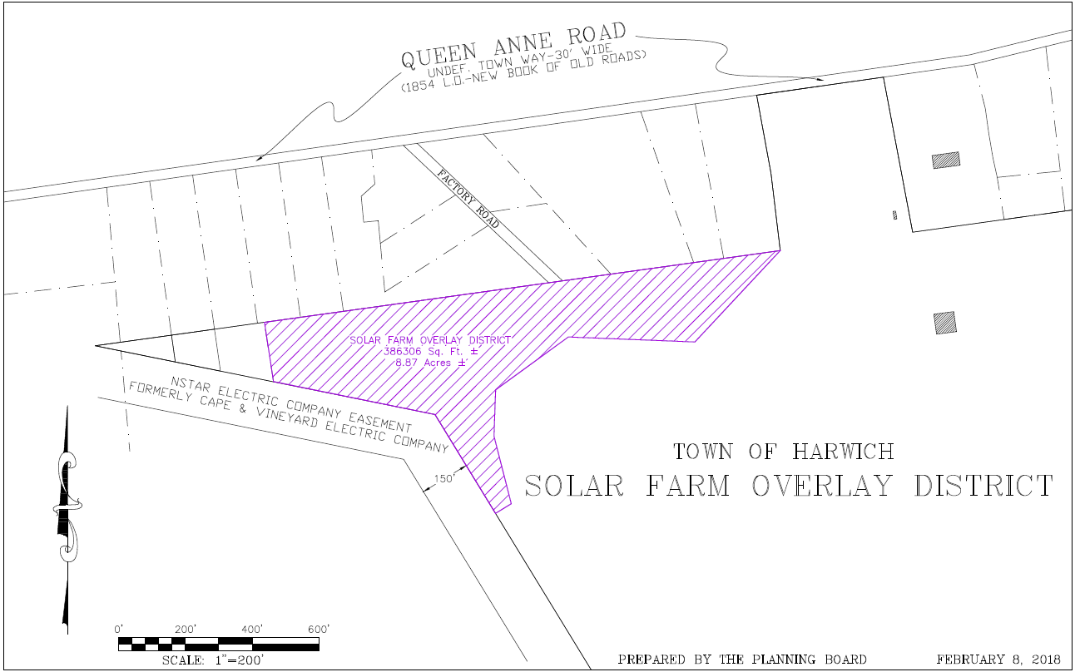

Slide 7
CriteriON 2 – Expedited Permitting
Applies only to the proposed Large-Scale Ground-Mounted Photovoltaic Use within the Solar Farm Overlay District
  The proposed bylaw contains wording indicating that this will be an expedited process
  Town Counsel must submit a letter, once the bylaw is approved, affirming that this will be an expedited process

Slide 8
CriteriON 3 – Energy baseline & 20% energy Reduction Plan
Funded by Cape Light Compact, Peregrine Energy Group, working with Town Facilities Maintenance Manager prepared a Portfolio-wide Building Assessment in Aug. 2016
Cape Light Compact, with State funding, will provide technical assistance to establish the energy baseline and create the five-year energy use reduction plan, using the Peregrine Report’s recommendations
The Town will work with Green Communities Southeast Regional Coordinator to update energy usage information within the MassEnergyInsight website

Slide 9
MassEnergy Insight is an essential web-based tool to help communities track and reduce their energy use with access to reports on electricity, natural gas, and oil use.
DOER offers MassEnergyInsight free to cities, towns, and regional governmental entities such as school districts or drinking water and wastewater districts.
This web-based tool provides access to energy information for multiple uses: buildings, vehicles, streetlights & traffic lights, and drinking water & wastewater treatment and pumping.

Slide 10
CriteriON 4 – Fuel Efficient Vehicles
Adopt a Fuel-Efficient Vehicle Policy requiring all municipal departments and divisions to purchase fuel-efficient vehicles, whenever such vehicles are commercially available and practicable,
  2 wheel drive car: 29 MPG
  4 wheel drive car: 24 MPG
  2 wheel drive minivan 20 MPG
  4 wheel drive minivan 18 MPG
  2 wheel drive pick-up truck: 17 MPG
  4 wheel drive pick-up truck: 16 MPG
  2 wheel drive sport utility vehicle: 21 MPG
  4 wheel drive sport utility vehicle: 18 MPG
Develop and maintain a vehicle inventory for all four-wheeled vehicles, and
Provide a plan for replacing non-exempt vehicles with vehicles that meet specified fuel efficiency ratings.
NOTE: Police Cruisers and Heavy Duty Vehicles >8,500 pounds are exempt

Slide 11


New 2018 Chevrolet Cruze
HWY: 40 MPG | CITY: 30 MPG †
29 mpg required by Green Communities
2017 Ford F-150 Raptor
16 MPG
16 mpg required by Green Communities

Slide 12
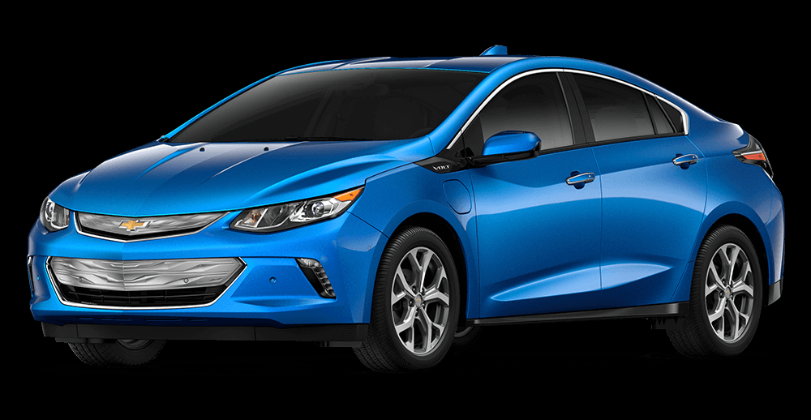
Chevy Volt
Vehicle Type: Cars, Four-Door Hatchback
Drivetrain: PHEV (plug in hybrid)
Electric Range: 53 mi
Total Range: 420 mi
Top Speed: 100 mph
Number of Seats: 5

Slide 13
CriteriON 5 – Stretch Code
Adoption of BBRS Stretch Code (780 CMR 115.AA) an appendix to the MA State Building Code
This only effects new residential construction and commercial over 100,000 square feet, not additions or renovations
The Stretch Code must be adopted as a general bylaw amendment within the Town Meeting Warrant and voted on by Town Meeting….requires a simple majority vote

Slide 14
What is a HERS rating?
The Home Energy Rating System (HERS) Index is the industry standard by which a home's energy efficiency is measured. It’s also the nationally recognized system for inspecting and calculating a home's energy performance.
A certified Home Energy Rater assesses the energy efficiency of a home, assigning it a relative performance score. The lower the number, the more energy efficient the home.
The U.S. Department of Energy has determined that a typical resale home scores 130 on the HERS Index while a standard new home is awarded a rating of 100.
A home with a HERS Index Score of 70 is 30% more energy efficient than a standard new home
A home with a HERS Index Score of 130 is 30% less energy efficient than a standard new home
The lower the score the better the rating

Slide 15
Some variables included in an energy rating are:
*All exterior walls (both above and below grade)
*Floors over unconditioned spaces (like garages or cellars)
*Ceilings and roofs
*Attics, foundations and crawlspaces
*Windows and doors, vents and ductwork
*HVAC system, water heating system, and your thermostat.
*Air leakage of the home
*Leakage in the heating and cooling distribution system

Slide 16
WHAT DOES SEER MEAN?
SEER stands for Seasonal Energy Efficiency Ratio. The SEER measures air conditioning and heat pump cooling efficiency, which is calculated by the cooling output for a typical cooling season divided by the total electric energy input during the same time frame.
A SEER rating is a maximum efficiency rating, similar to the miles per gallon for your car. Your car might get 28 miles per gallon on the highway, but if you’re stuck in city traffic it could be lower. If your air conditioner is 21 SEER, that’s its maximum efficiency.
A higher SEER rating means greater energy efficiency. The minimum standard SEER is 13 for air conditioners. Most modern air conditioners have a SEER that ranges from 13 to 21.

Slide 19
Green communities designation and granT program
Grant allocation based on a $125,000 base, plus a population/per capita income formula. Harwich could receive between $140-150,000
Over $80M awarded in total for both designation and competitive grants programs
Projects being funded include electric and thermal (natural gas and fuel oil) energy conservation measures, incremental costs for hybrid vehicles and grant administration costs

Slide 20
Questions?

