Slide 1
Article 39
Chapter 325, Article XXIII Large Scale Ground
Mounted Photovoltaic Arrays Section 144(D)
Design Standards
Accessory Residential Photovoltaic Arrays
Residential Solar Panel Regulations

Slide 2
New Regulations for Residential Solar Panels
Goals
Reasonable regulations for ground and roof mounted solar photovoltaic panels.
Promote solar energy development as accessory use
Allow them By-Right with building & electrical permits
Avoid regulations that limit or prohibit technological advancements

Slide 3
Ground Mounted Solar Panels

Slide 4
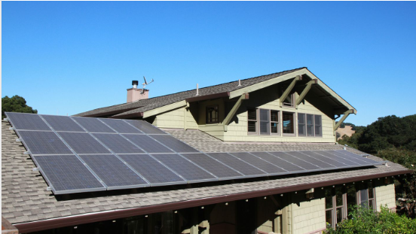
Roof Mounted Solar Panels

Slide 5
Current Zoning Regulations
The Zoning Bylaw only regulates large-scale, commercial solar energy production.
No regulations on the placement, height, setbacks or screening of residential solar panels.
This amendment will establish some basic regulations to protect residential neighborhoods.

Slide 6
Residential Solar Panels
Goals of the Regulations
Allowed as accessory use to a residential dwelling
Minimize the view of installations
Protect abutting property owners
Protect residential property values

Slide 7
Benefits of Solar Energy
Reduces dependency on foreign energy such as oil and gas
Decentralized natural source of energy
Clean renewable energy
Lower electric bills

Slide 8
New Solar Installation Regulations
Ground Mounted
Must meet setback requirements in the applicable zoning district
Solar panels shall not exceed 15 feet in height.
Solar panels shall be screened from view from any public or private way.

Slide 9
New Solar Installation Regulations
Panels must be screened with a minimum of a six foot high solid fence or densely planted evergreen buffer.
Location – Accessory Residential Ground mounted solar panels shall be mounted in the rear yard behind the rear building line.

Slide 10
New Solar Installation Regulations
Accessory Residential Rooftop Solar Installations
Solar panels shall not extend over the edge of the roof
Shall not extend above the ridge line of the roof

Slide 11
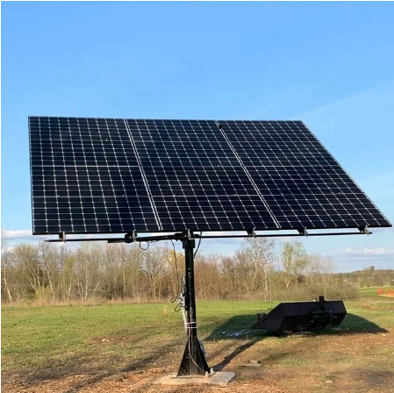
Questions?
Select Board & Planning Board Recommend Approval

