Slide 1


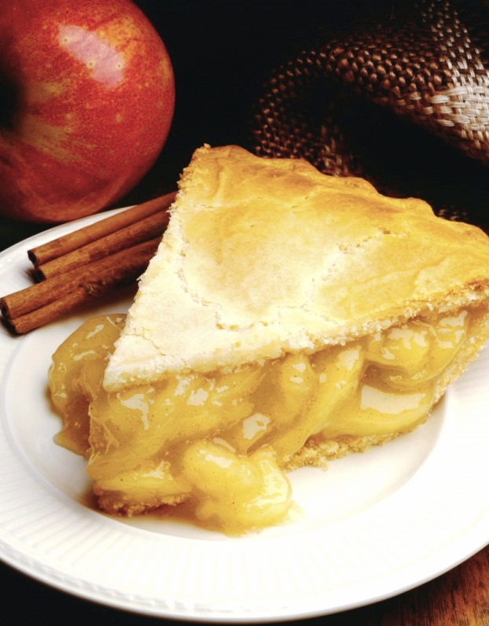
Understanding the New Food Code
Overview of changes, additions, deletions
Notes:
NOTE: To replace a picture, just select and delete it. Then use the Insert Picture icon to replace it with one of your own!

Slide 2

Agenda
Introductions
New Risk Designations
Significant Regulatory Changes since 1999 (using the 2013 FDA Food Code, with 2015 supplement, and 105 CMR 590.000)
Inspection Report Form
Q & A
Note: This is a partial summary and does not include every change from the previous versions of 105 CMR 590 to the version effective on October 5, 2018. Please refer to the official version of 105 CMR 590 in the MA Register for the full text of the regulation.

Slide 3
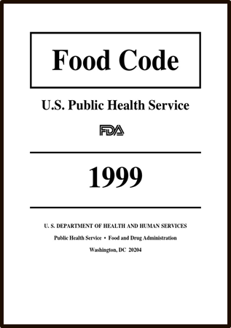
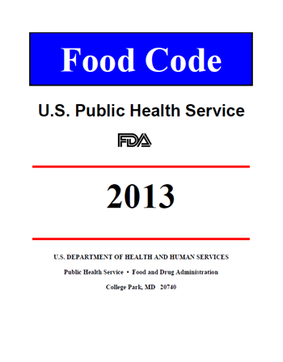


On September 12, 2018, the Massachusetts Department of Public Health amended 105 CMR 590.00: State Sanitary Code Chapter X: Minimum Sanitation Standards for Food Establishments to include sections of the 2013 FDA Food Code, with amendments made by FDA in 2015. The amendments to 105 CMR 590.000 were published in the Massachusetts register on October 5, 2018 and became effective upon publication.
⇧

Slide 4

New Risk Designations
The former use of “critical” or “non-critical” has been changed in recognition of the need to better identify risk-based controls within the Code’s provisions.
A “P” or “Pf” designation after a paragraph or subparagraph indicates that the provision within that section is a PRIORITY ITEM or PRIORITY FOUNDATION ITEM. Any unmarked provisions within a section are CORE ITEMS.
1999 | 2013
Violations Related to Foodborne Illness Intervention and Risk Factors (red items) | Priority Items
Critical Violations (blue items) | Priority Foundation Items
Non-critical violations (black items) | Core Items

Slide 5
New Definition of “Priority Item”
Priority item means a provision in this Code whose application contributes directly to the elimination, prevention or reduction to an acceptable level, hazards associated with foodborne illness or injury and there is no other provision that more directly controls the hazard.
Priority item includes items with a quantifiable measure to show control of hazards such as cooking, reheating, cooling, handwashing
Priority item is an item that is denoted in this Code with a superscript ^{P}
The term Priority Item implies an importance and need for immediate correction
Example:
Priority (P)
590.002; FC 2-301.12 Cleaning Procedure
Observation – Employees not washing hands properly.

Slide 6
New Definition of “Priority Foundation Item”
Priority foundation item means a provision in this Code whose application supports, facilitates or enables one or more Priority Items.
Priority foundation item includes an item that requires the purposeful incorporation of specific actions, equipment or procedures by industry management to attain control of risk factors that contribute to foodborne illness or injury such as personnel training, infrastructure or necessary equipment, HACCP plans, documentation or record keeping, and labeling.
Priority foundation Item is an item that is denoted in this Code with a
superscript ^{Pf}
The term Priority Foundation links the provision to a Priority Item
Example:
Priority Foundation (Pf)
590.006; FC 6.301.11 Handwashing Cleanser, Availability
Observation – No soap available at the handwashing sink.

Slide 7
New Definition of “Core Item”
Core item means a provision in this Code that is not designated as a Priority Item or a Priority Foundation Item.
Core item includes an item that usually relates to general sanitation, operational controls, sanitation standard operating procedures (SSOPs), facilities or structures, equipment design, or general maintenance.
A Core Item has no specific superscript designation in the Code.
Example:
Core (C)
590.00; FC 6-301.14 Handwashing Signage
Observation – There was no sign indicating that employees must wash their hands.

Slide 8
590.008; FC 8-405.11 & FC 8-406.11 Timely Correction
Considering the nature of the potential hazard involved and the complexity of the corrective action needed, the regulatory authority may agree to or specify a longer time frame not to exceed:
Priority Item:
Corrected at time of inspection or 72 hours after inspection
Priority Foundation Item:
Corrected at time of inspection or 10 calendar days after inspection
Core Item:
As agreed to or specified by the regulatory authority, but no later than 90 calendar days after the inspection

Slide 9
CHAPTER 1
Definitions
FC 1-201.10; 590.001(C)
Additions, changes

Slide 10
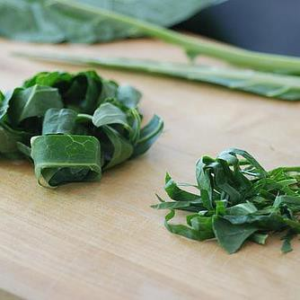
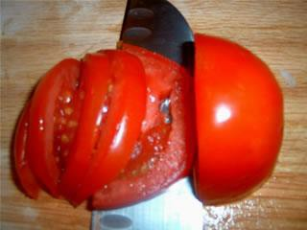
Time/Temperature Control for Safety Food (TCS)
“Time/Temperature Control for Safety Food” (TCS Food) means a food that requires time/temperature control for safety (TCS) to limit pathogenic microorganism growth or toxin formation.
Replaced the term “Potentially Hazardous Food” (PHF) with Time/Temperature Control for Safety Food (TCS Food) to identify foods that require cold holding or hot holding during storage and display.
Added cut leafy greens and cut tomatoes or mixture of cut tomatoes that are not modified in a way so that they are unable to support pathogenic microorganism growth or toxin formation.

Slide 11
CHAPTER 2
Management and Personnel
Additions, changes

Slide 12
590.002(B); FC 2-102.11 Person in Charge – Demonstration^{Pf}
(A) Complying with this Code by having no violations of PRIORITY ITEMS during the current inspection;
(B) Being a certified FOOD protection manager who has shown proficiency of required information through passing a test that is part of an ACCREDITED PROGRAM; AND
(C) Responding correctly to the inspector's questions as they relate to the specific FOOD operation. . .
NEW: 2-102.11 (C) (9) Describing foods identified as major allergens and the symptoms that a major food allergy could cause in a sensitive individual who has an allergic reaction.

Slide 13
590.002 (D); FC 2-103.11 PIC Duties^{Pf}
(F) EMPLOYEES are verifying that FOODS delivered to the FOOD ESTABLISHMENT during non-
operating hours are from APPROVED sources and are placed into appropriate storage
locations such that they are maintained at the required temperatures, protected from
contamination, unadulterated, and accurately presented. ^{Pf}
EMPLOYEES are properly maintaining the temperatures of TIME/TEMPERATURE CONTROL FOR SAFETY FOODS during hot and cold holding through daily oversight of the EMPLOYEES’ routine monitoring of FOOD temperatures. ^{Pf}
(M) EMPLOYEES are preventing cross contamination of READY-TO-EAT FOOD with bare
hands by properly using suitable UTENSILS such as deli tissue, spatulas, tongs, single-use gloves, or dispensing EQUIPMENT. ^{Pf}

Slide 14
590.002 (D); FC 2-103.11 PIC Duties^{Pf}
(N) EMPLOYEES are properly trained in FOOD safety, including food allergy awareness, as it relates to their assigned duties ^{Pf}
(O) FOOD EMPLOYEES and CONDITIONAL EMPLOYEES are informed in a verifiable manner of their responsibility to report in accordance with LAW, to the PERSON IN CHARGE, information about their health and activities as they relate to diseases that are transmissible through FOOD, as specified under ¶ 2-201.11(A). ^{Pf}
(P) Written procedures and plans, where specified by this Code and as developed by the FOOD ESTABLISHMENT, are maintained and implemented as required. ^{Pf}

Slide 15
Employee Health & Hygiene
590.002 (E); FC 2-201.11 Reportable Symptoms
Vomiting
Diarrhea
Jaundice
Fever with Sore Throat
Lesions containing pus on hand, wrist or exposed portions of the arm
Fever (no longer reportable)

Slide 16
590.002 (E); FC 2-201.11; FC 2-201.11
Reportable History of Exposure
Exposure to, or suspicion of causing any confirmed outbreak of the diseases listed below:
A household member has been diagnosed with one or more of the diseases listed below:
A household member attended, or is working in a setting experiencing a confirmed outbreak of one of the diseases listed below:
      Norovirus within the past 48 hours after last exposure
      Shiga toxin-producing E. coli (STEC) or Shigella spp. within the past 3 days of the last exposure
    Salmonella typhi within the past 14 days of the last exposure
    Hepatitis A within the past 30 days of the last exposure
  Remind employees to report reportable symptoms and ensure compliance with good hygienic practices, handwashing, and no bare hand contact with ready-to-eat foods.

Slide 17
590.002 (G); FC 2-201.20
Prevention of Foodborne Cases of Viral Gastroenteritis
This is a completely new section of 105 CMR 590:
Food handlers who test positive for Norwalk virus, Norwalk-like virus, or any other calicivirus shall be excluded from handling duties for either 72 hours past the resolution of symptoms, or 72 hours past the date the positive specimen was provided, whichever occurs last.
In outbreak circumstances consistent with Norwalk virus, Norwalk-like virus, or any other calicivirus infection, affecting patrons or food handlers, food handling facility employees may be required to provide stool specimens for testing.

Slide 18
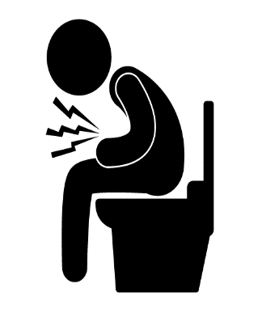
Responding to Contamination Events
Completely new subpart to Chapter 2 of the FDA Food Code
Requires food establishments to have procedures to follow when responding to vomiting or diarrheal events that involve the discharge of vomitus or fecal matter onto surfaces in the establishment.
Procedures shall address the specific actions employees must take to minimize the spread of contamination and the exposure of employees, consumers, food, and surfaces to vomitus or fecal matter.
Putting the proper response into action in a timely manner can help reduce the likelihood that food may become contaminated and that others may become ill as a result of the accident.
video

Slide 19

590.002; FC 2-301.14 When to Wash Hands^{P}
Amended to read:
Food employees shall clean their hands and exposed portions of their arms as specified under 590.002; FC 2-301.12 immediately before engaging in food preparation including working with exposed food, clean equipment and utensils, and unwrapped single-service and single-use articles and
(H) Before donning gloves to initiate a task that involves working with food

Slide 20
CHAPTER 3
Food

Slide 21
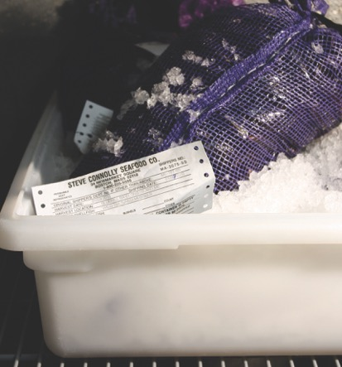
590.003; FC 3-203.12
Shellstock, Maintaining Identification ^{Pf}
(A) Except as specified under (C)(2) of this section,
shellstock tags shall remain attached to the
container in which the shellstock are received
until the container is empty.
(B) The date when the last shellstock from the
container is sold or served shall be recorded
on the tag or label.
(C) The identity of the source of SHELLSTOCK that
are sold or served shall be maintained by
retaining SHELLSTOCK tags or labels for 90
calendar days from the date that is
recorded on the tag or label (last sold/served
date).

Slide 22
(C)(2) If shellstock are removed from its tagged or labeled container:
(a) Preserving source identification by using an approved
record keeping system that keeps the tags or labels in
chronological order correlated to the date that is recorded on
the tag or label (last sold/served date),
(b) Ensuring that shellstock from one tagged or labeled container
are not commingled with shellstock from another container
with different certification numbers; different harvest dates;
or different growing areas as identified on the tag or label
before being ordered by the consumer.

Slide 23
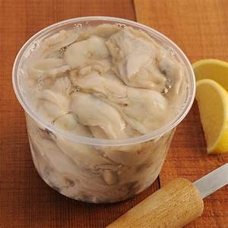
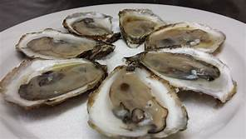
590.003 (B); FC 3-203.11
Shellfish, Original Container
Paragraph (D) was deleted.
Shucked shellfish may NOT be removed from the container in which they were received and repacked in self service containers.
Note: Good Manufacturing Regulations for Food – specifically section 105 CMR 500.020 (B) (2) d and e, prohibits high hazard processing, such as shucking and meat picking, and removing shellfish meats from the shell at the retail level. However, shellfish meat prepared and served "on the half-shell" is permitted by DPH. If a retailer wants to conduct any of these high hazard processes, they must apply for a variance from DPH.

Slide 24

590.003; FC 3-401.11 Cooking ^{P}
(C) A raw or partially cooked animal food may be served or offered for sale upon
consumer request or selection in a R-T-E form if:
(D)(2) The food is served or offered for service by consumer selection from a
children’s menu, does not contain comminuted meat, and ……
Simply stated: ground meats cannot be offered raw or undercooked from a
child’s menu.
“Meat” means the flesh of animals used as food, including the dressed flesh of cattle, swine, sheep, or goats and other edible animals, except fish, poultry, and wild game animals as specified under subparagraphs 3-201.17 (s)(3) and (4).

Slide 25
590.003; FC 3-401.14
Non-Continuous Cooking of Raw Animal Foods
Non-continuous cooking means raw animal food is intentionally cooked to a temperature below the minimum required temperature during the first cook/heat and then cooled. The cooking process is completed at a later date or time during the second cook.
NOTE: raw animal foods that are not cooled after the initial heat/cook are not included in the definition of non-continuous cooking.

Slide 26
590.003; FC 3-401.14
Non-Continuous Cooking of Raw Animal Foods
Raw animal FOODS that are cooked using a NON-CONTINUOUS COOKING process shall be:
Subject to an initial heating process that is no longer than sixty minutes in duration^{P}
(B) Immediately after initial heating, cooled according to the time and temperature parameters specified for cooked TCS Food ^{P}
(C) After cooling, held frozen or cold, as specified TCS foods; ^{P}
Prior to sale or service, cooked using a process that heats all parts of the food to a temperature and for a time as specified in the Food Code; ^{P}
(E) Cooled according to the time and temperature parameters specified in the Food Code for TCS foods ^{P}
And…

Slide 27
590.003; FC 3-401.14
Non-Continuous Cooking of Raw Animal Foods
(F) Prepared and stored according to written procedures that: ^{Pf}
  (1) Have obtained prior approval from the regulatory authority;
  (2) Are maintained in the food establishment and are available to the regulatory authority upon request;
  (3) Describe how the requirements specified under ¶ (A)­-(E) of this Section are to be monitored and documented by the permit holder and the corrective actions to be taken if the requirements are not met;
  (4) Describe how the foods, after initial heating, but prior to complete cooking, are to be marked or otherwise identified as foods that must be cooked as specified under ¶ (D) of this section prior to being offered for sale or service; and
  (5) Describe how the foods, after initial heating but prior to cooking as specified under ¶(D) of this section, are to be separated from ready-to-eat foods

Slide 28
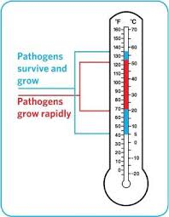
New Temperature Danger Zone
New Temperature Danger Zone 41°F - 135°F
590.003; FC 3-202.11
Receiving hot foods - now 135°F or above.
590.003; FC 3-304.12
In-use utensil – may now be stored in hot water at 135°F or above.
590.003; FC 3-401.13
Cooking fruits and vegetables for hot holding 135°F or above (no cooking requirement if cooked for immediate service).
590.003; FC 3-501.16
Hot holding is now 135°F or above.
590.003; FC 3-501.14
Cooling - now 135°F to 70°F in first 2 hours and then from 70°F to 41°F within the next 4 hours. Whole process not to exceed 6 hours.
590.003; FC 3-403.11
Reheating commercially processed TCS foods - must now be reheated to 135°F or above.

Slide 29
590.003; FC 3-304.17 Refilling Returnables
Except as specified in ¶¶ (B) - (E) of this section, empty containers returned to a food establishment for cleaning and refilling with food shall be cleaned and refilled in a regulated food processing plant. ^{P}
(B) A take-home food container returned to a food establishment may be refilled at a food establishment with food if the food container is:
(1) Designed and constructed for reuse^{P;}
(2) One that was initially provided by the food establishment to the consumer, either empty or filled with food by the food establishment, for the purpose of being returned for reuse;
(3) Returned to the food establishment by the consumer after use; and
(4) Subject to the following steps before being refilled with food:
  (a) Cleaned properly,
  (b) Sanitized properly; ^{P}
  (c) Visually inspected by a FOOD EMPLOYEE to verify that the container, as
  returned, meets the requirements specified under Part 4-1 and 4-2; ^{P} and

Slide 30
Refilling Returnables Cont’d
(C) A take-home food container returned to a food establishment may be refilled at a
food establishment with a beverage if:
(1) The beverage is not a time/temperature control for safety food;
(2) The design of the container and of the rinsing equipment and the nature of
the beverage, when considered together, allow effective cleaning at home or
in the food establishment;
(3) Facilities for rinsing before refilling returned containers with fresh, hot water
that is under pressure and not recirculated are provided as part of the
dispensing system;
(4) The consumer-owned container returned to the food establishment for
refilling is refilled for sale or service only to the same consumer; and

Slide 31
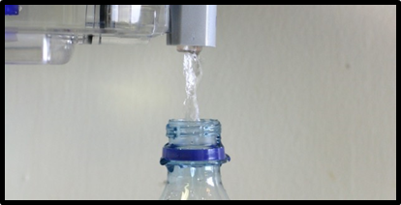
Refilling Returnables Cont’d
(5) The container is refilled by:
(a) An employee of the food establishment , or
(b) The owner of the container if the BEVERAGE system includes a contamination- free transfer process that cannot be bypassed by the container owner.
(D) Consumer-owned, personal take-out beverage containers, such as thermally insulated bottles, nonspill coffee cups, and promotional BEVERAGE glasses, may be refilled by employees or the consumer if refilling is a contamination- free process.
(E) Consumer-owned containers that are not food-specific may be filled at a water vending machine or system.

Slide 32
590.003; FC 3-502.11 Variance Required^{Pf}
Smoking Food (only as method of food preservation)
Curing Food
Using Food Additives (i.e. vinegar) as food preservation or to render food a non TCS food
Reduced Oxygen Packaging (ROP)
Molluscan shellfish life-support system display tanks for consumption – must obtain additional variance for wet storage systems from DPH (105 CMR 500.021(D).
Custom Processing of Animals
Preparing food by another method that is determined by RA to require a variance
Sprouting seeds – NEW!
NOTE: HACCP plan required for all activities requiring a variance

Slide 33
590.003; FC 3-502.12
Reduced Oxygen Packaging Without a Variance (need a HACCP plan)
No variance OR HACCP plan required if:
  Always labeled with production time & date
  Held at 41°For lower
  Removed from packaging within 48 hours.

Slide 34
CHAPTER 4
Equipment, Utensils and Linens

Slide 35
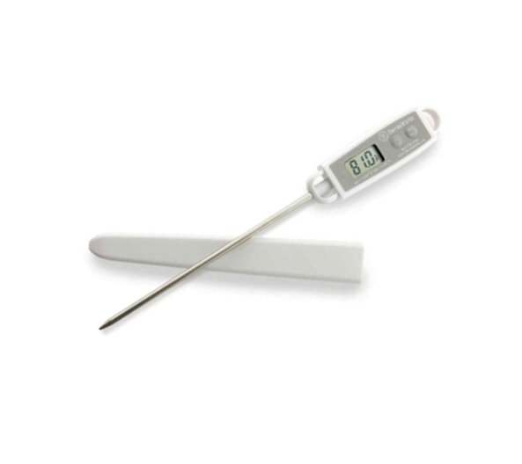
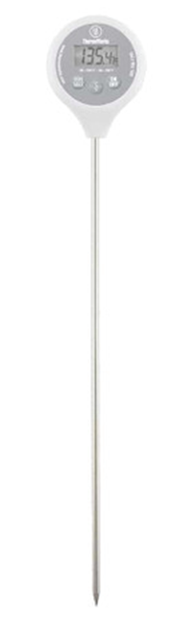
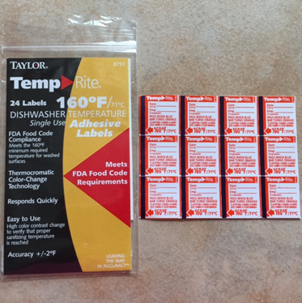
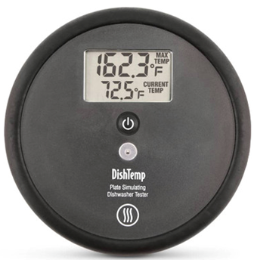
590.004; FC 4-302.13 (A)
Temperature Measuring Devices
In manual warewashing operations, a temperature measuring device shall be provided and readily accessible for frequently measuring the washing and sanitizing temperature. ^{Pf}
In hot water mechanical warewashing operations, an irreversible registering temperature indicator shall be provided and readily
accessible for measuring the utensil surface temperature.

Slide 36
CHAPTER 8
Compliance & Enforcement

Slide 37
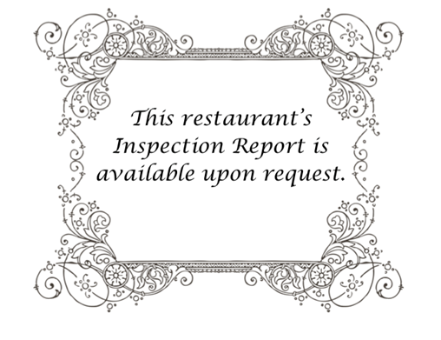
590.008; FC 8-304.11
Responsibilities of the Permit Holder
Amended to add new ¶(K) to include a requirement for the permit holder to notify customers that a copy of the most recent establishment inspection report is available upon request by posting a sign or placard in a location in the food establishment that is conspicuous to customers or by another method acceptable to the regulatory authority.
A copy of our most recent inspection report is available upon request.

Slide 38
Inspection Form
New look of the form and
Violation correction timeframes

Slide 39
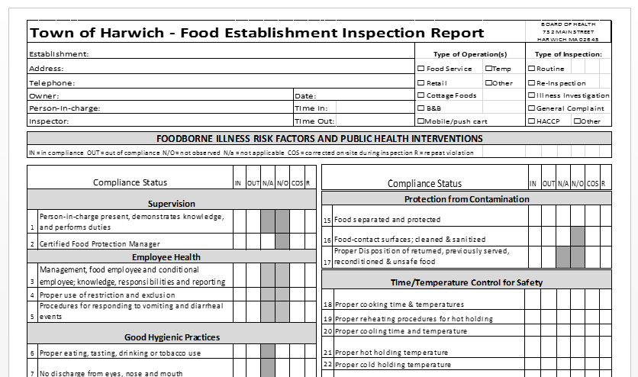
What’s New on Page 1
Compliance Status
IN = In Compliance
OUT = Out of Compliance
NO = Not observed
NA = Not applicable
COS = corrected on-site during inspection
R = repeat violation

Slide 40
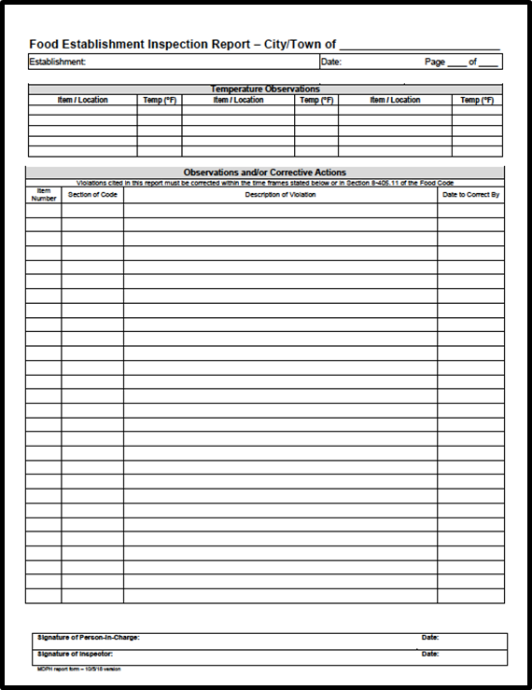
New Page 2
Temperature Observations
Temperature observations are documented in this section.
Observations and/or Corrective Actions
Each violation of the code should be documented in the “Observations and Corrective Actions” section.
8-405.11 Timely Correction:
Immediate correction if required by the inspector
Within 72 hours of the inspection for a PRIORITY ITEM
10 calendar days after the inspection for a PRIORITY FOUNDATION ITEM

Slide 41
8-405.11 Timely Correction:
Immediate correction if required by the inspector
Within 72 hours of the inspection for a PRIORITY ITEM
10 calendar days after the inspection for a PRIORITY FOUNDATION ITEM
Correction of a CORE ITEM by a date and time agreed to by the REGULATORY AUTHORITY, but no later than 90 calendar days after the inspection.
The REGULATORY AUTHORITY may approve a compliance schedule that extends beyond the time limits if a written schedule of compliance is submitted and no health hazard exists.

Slide 42
References

Slide 43


